Slide 1
Chapter 3
Style Sheets:
CSS
WEB TECHNOLOGIES
A COMPUTER SCIENCE PERSPECTIVE
JEFFREY C. JACKSON
Jackson, Web Technologies: A Computer Science Perspective, © 2007 Prentice-Hall, Inc. All rights reserved. 0-13-185603-0

Slide 2
Motivation
HTML markup can be used to represent
  Semantics: h1 means that an element is a top-level heading
  Presentation: h1 elements look a certain way
It’s advisable to separate semantics from presentation because:
  It’s easier to present documents on multiple platforms (browser, cell phone, spoken, …)
  It’s easier to generate documents with consistent look
  Semantic and presentation changes can be made independently of one another (division of labor)
  User control of presentation is facilitated
Jackson, Web Technologies: A Computer Science Perspective, © 2007 Prentice-Hall, Inc. All rights reserved. 0-13-185603-0

Slide 3
Style Sheet Languages
Cascading Style Sheets (CSS)
  Applies to (X)HTML as well as XML documents in general
  Focus of this chapter
Extensible Stylesheet Language (XSL)
  Often used to transform one XML document to another form, but can also add style
  XSL Transformations covered in later chapter
Jackson, Web Technologies: A Computer Science Perspective, © 2007 Prentice-Hall, Inc. All rights reserved. 0-13-185603-0

Slide 4
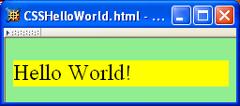
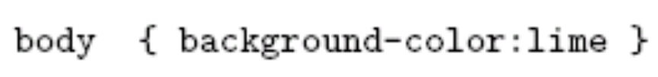
CSS Introduction
A styled HTML document
produced by the style sheet style1.css:
Jackson, Web Technologies: A Computer Science Perspective, © 2007 Prentice-Hall, Inc. All rights reserved. 0-13-185603-0

Slide 5
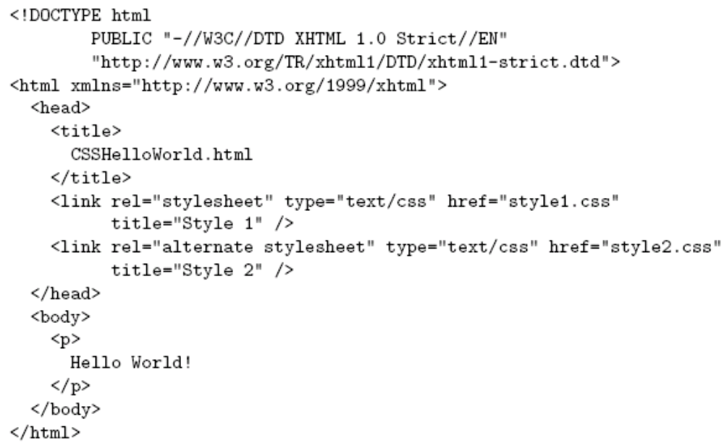
CSS Introduction
link element associates style sheet with doc.
Jackson, Web Technologies: A Computer Science Perspective, © 2007 Prentice-Hall, Inc. All rights reserved. 0-13-185603-0

Slide 6
CSS Introduction
type attribute specifies style language used
Jackson, Web Technologies: A Computer Science Perspective, © 2007 Prentice-Hall, Inc. All rights reserved. 0-13-185603-0

Slide 7
CSS Introduction
href attribute provides style sheet URL
Jackson, Web Technologies: A Computer Science Perspective, © 2007 Prentice-Hall, Inc. All rights reserved. 0-13-185603-0

Slide 8
CSS Introduction
title attribute provides style sheet name
Jackson, Web Technologies: A Computer Science Perspective, © 2007 Prentice-Hall, Inc. All rights reserved. 0-13-185603-0

Slide 9
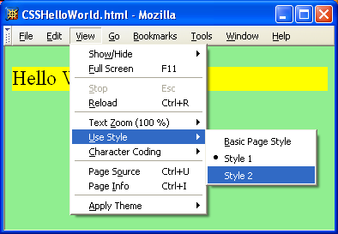
CSS Introduction
Jackson, Web Technologies: A Computer Science Perspective, © 2007 Prentice-Hall, Inc. All rights reserved. 0-13-185603-0

Slide 10
CSS Introduction
Alternative, user selectable style sheets
can be specified
Jackson, Web Technologies: A Computer Science Perspective, © 2007 Prentice-Hall, Inc. All rights reserved. 0-13-185603-0

Slide 11
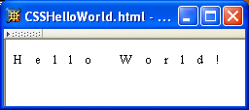
CSS Introduction
A styled HTML document
produced by the style sheet style2.css:
Jackson, Web Technologies: A Computer Science Perspective, © 2007 Prentice-Hall, Inc. All rights reserved. 0-13-185603-0

Slide 12
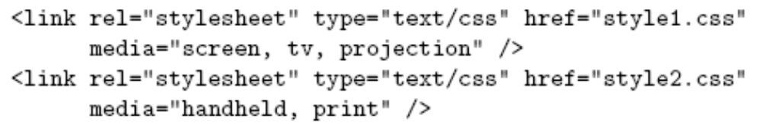
CSS Introduction
Single document can be displayed on multiple media platforms by tailoring style sheets:
This document will be printed differently than it is displayed.
Jackson, Web Technologies: A Computer Science Perspective, © 2007 Prentice-Hall, Inc. All rights reserved. 0-13-185603-0

Slide 13
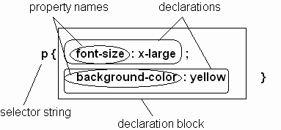
CSS Syntax
Parts of a style rule (or statement)
Jackson, Web Technologies: A Computer Science Perspective, © 2007 Prentice-Hall, Inc. All rights reserved. 0-13-185603-0

Slide 14

CSS Syntax:
Selector Strings
Single element type:
Multiple element types:
All element types:
Specific elements by id:
Jackson, Web Technologies: A Computer Science Perspective, © 2007 Prentice-Hall, Inc. All rights reserved. 0-13-185603-0

Slide 15
CSS Syntax:
Selector Strings
Single element type:
Multiple element types:
All element types:
Specific elements by id:
type selector
Jackson, Web Technologies: A Computer Science Perspective, © 2007 Prentice-Hall, Inc. All rights reserved. 0-13-185603-0

Slide 16
CSS Syntax:
Selector Strings
Single element type:
Multiple element types:
All element types:
Specific elements by id:
universal selector
Jackson, Web Technologies: A Computer Science Perspective, © 2007 Prentice-Hall, Inc. All rights reserved. 0-13-185603-0

Slide 17
CSS Syntax:
Selector Strings
Single element type:
Multiple element types:
All element types:
Specific elements by id:
ID selector
Jackson, Web Technologies: A Computer Science Perspective, © 2007 Prentice-Hall, Inc. All rights reserved. 0-13-185603-0

Slide 18
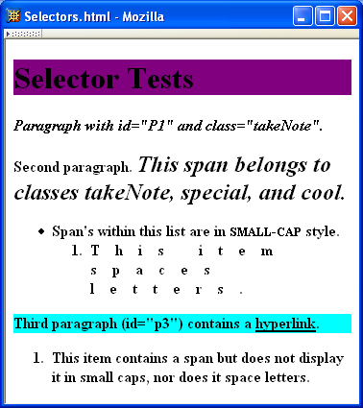
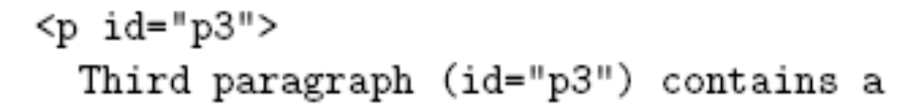
CSS Syntax:
Selector Strings
Jackson, Web Technologies: A Computer Science Perspective, © 2007 Prentice-Hall, Inc. All rights reserved. 0-13-185603-0

Slide 19
CSS Syntax:
Selector Strings
Elements belonging to a style class:
  Referencing a style class in HTML:
Elements of a certain type and class:
class selector
Jackson, Web Technologies: A Computer Science Perspective, © 2007 Prentice-Hall, Inc. All rights reserved. 0-13-185603-0

Slide 20
CSS Syntax:
Selector Strings
Elements belonging to a style class:
  Referencing a style class in HTML:
Elements of a certain type and class:
this span belongs to three style classes
Jackson, Web Technologies: A Computer Science Perspective, © 2007 Prentice-Hall, Inc. All rights reserved. 0-13-185603-0

Slide 21
CSS Syntax:
Selector Strings
Elements belonging to a style class:
  Referencing a style class in HTML:
Elements of a certain type and class:
this rule applies only to span’s belonging to class special
Jackson, Web Technologies: A Computer Science Perspective, © 2007 Prentice-Hall, Inc. All rights reserved. 0-13-185603-0

Slide 22
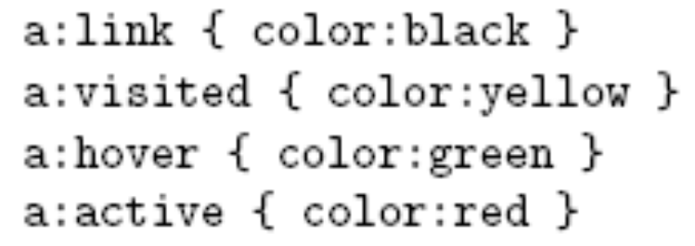
CSS Syntax:
Selector Strings
Source anchor elements:
Element types that are descendents:
pseudo-classes
Jackson, Web Technologies: A Computer Science Perspective, © 2007 Prentice-Hall, Inc. All rights reserved. 0-13-185603-0

Slide 23
CSS Syntax:
Selector Strings
Source anchor elements:
Element types that are descendants:
rule applies to li element that is
Jackson, Web Technologies: A Computer Science Perspective, © 2007 Prentice-Hall, Inc. All rights reserved. 0-13-185603-0

Slide 24
CSS Syntax:
Selector Strings
Source anchor elements:
Element types that are descendants:
rule applies to li element that is
part of the content of an ol element
Jackson, Web Technologies: A Computer Science Perspective, © 2007 Prentice-Hall, Inc. All rights reserved. 0-13-185603-0

Slide 25
CSS Syntax:
Selector Strings
Source anchor elements:
Element types that are descendants:
rule applies to li element that is
part of the content of an ol element
that is part of the content of a ul element
Jackson, Web Technologies: A Computer Science Perspective, © 2007 Prentice-Hall, Inc. All rights reserved. 0-13-185603-0

Slide 26
CSS Syntax
Style rules covered thus far follow ruleset syntax
At-rule is a second type of rule
  Reads style rules from specified URL
  Must appear at beginning of style sheet
URL relative to style sheet URL
Jackson, Web Technologies: A Computer Science Perspective, © 2007 Prentice-Hall, Inc. All rights reserved. 0-13-185603-0

Slide 27
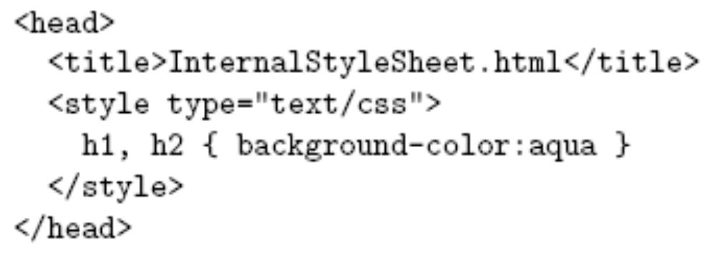
Style Sheets and HTML
Style sheets referenced by link HTML element are called external style sheets
Style sheets can be embedded directly in HTML document using style element
Most HTML elements have style attribute (value is list of style declarations)
Jackson, Web Technologies: A Computer Science Perspective, © 2007 Prentice-Hall, Inc. All rights reserved. 0-13-185603-0

Slide 28
Style Sheets and HTML
Rules of thumb:
  Use external style sheets to define site-wide style
  Prefer style sheets (either external or embedded) to style attributes
  XML special characters
    Must use references in embedded style sheets and style attribute
    Must not use references in external style sheets
Jackson, Web Technologies: A Computer Science Perspective, © 2007 Prentice-Hall, Inc. All rights reserved. 0-13-185603-0

Slide 29

CSS Rule Cascade
What if more than one style declaration applies to a property of an element?
The CSS rule cascade determines which style rule’s declaration applies
Jackson, Web Technologies: A Computer Science Perspective, © 2007 Prentice-Hall, Inc. All rights reserved. 0-13-185603-0

Slide 30
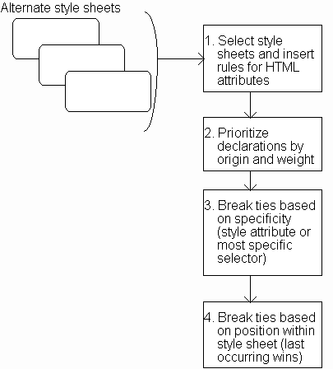
CSS Rule Cascade
Jackson, Web Technologies: A Computer Science Perspective, © 2007 Prentice-Hall, Inc. All rights reserved. 0-13-185603-0

Slide 31
CSS Rule Cascade
Select appropriate style sheets based
on user selection and media type.
Jackson, Web Technologies: A Computer Science Perspective, © 2007 Prentice-Hall, Inc. All rights reserved. 0-13-185603-0

Slide 32
CSS Rule Cascade
Five origin/weight levels:
user/important
author/important
author/normal
user/normal
user agent/normal
Jackson, Web Technologies: A Computer Science Perspective, © 2007 Prentice-Hall, Inc. All rights reserved. 0-13-185603-0

Slide 33
CSS Rule Cascade
User can define a style sheet
  Explicitly (easy in IE)
  Implicitly (preferences)
User/important highest priority in CSS2 to accommodate users with special needs
  Rules made important by adding “!important”:
Jackson, Web Technologies: A Computer Science Perspective, © 2007 Prentice-Hall, Inc. All rights reserved. 0-13-185603-0

Slide 34
CSS Rule Cascade
Specificity:
style attribute
rule with selector:
  ID
  class/pseudo-class
  descendant/element type
  universal
Jackson, Web Technologies: A Computer Science Perspective, © 2007 Prentice-Hall, Inc. All rights reserved. 0-13-185603-0

Slide 35
CSS Rule Cascade
Conceptually, create one
long style sheet. Later
style rules have higher
priority than earlier rules.
Jackson, Web Technologies: A Computer Science Perspective, © 2007 Prentice-Hall, Inc. All rights reserved. 0-13-185603-0

Slide 36
CSS Inheritance
What if no style declaration applies to a property of an element?
Generally, the property value is inherited from the nearest ancestor element that has a value for the property
If no ancestor has a value (or the property does not inherit) then CSS defines an initial value that is used
Jackson, Web Technologies: A Computer Science Perspective, © 2007 Prentice-Hall, Inc. All rights reserved. 0-13-185603-0

Slide 37
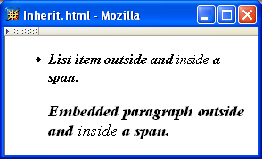
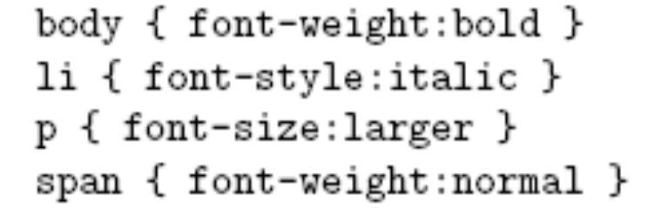
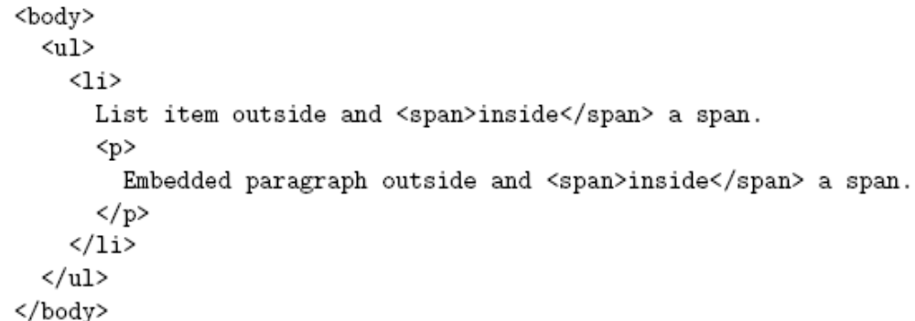
CSS Inheritance
Jackson, Web Technologies: A Computer Science Perspective, © 2007 Prentice-Hall, Inc. All rights reserved. 0-13-185603-0

Slide 38
CSS Inheritance
Property values:
  Specified: value contained in declaration
    Absolute: value can be determined without reference to context (e.g., 2cm)
    Relative: value depends on context (e.g., larger)
  Computed: absolute representation of relative value (e.g., larger might be 1.2 x parent font size)
  Actual: value actually used by browser (e.g., computed value might be rounded)
Jackson, Web Technologies: A Computer Science Perspective, © 2007 Prentice-Hall, Inc. All rights reserved. 0-13-185603-0

Slide 39
CSS Inheritance
Most properties inherit computed value
  Exception discussed later: line-height
A little thought can usually tell you whether a property inherits or not
  Example: height does not inherit
Jackson, Web Technologies: A Computer Science Perspective, © 2007 Prentice-Hall, Inc. All rights reserved. 0-13-185603-0

Slide 40
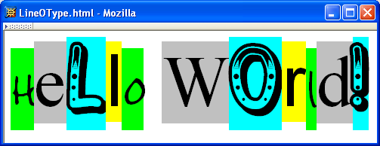
CSS Font Properties
A font is a mapping from code points to glyphs
glyph
character cell
(content area)
Jackson, Web Technologies: A Computer Science Perspective, © 2007 Prentice-Hall, Inc. All rights reserved. 0-13-185603-0

Slide 41
CSS Font Properties
A font is a mapping from code points to glyphs
glyphs do not necessary stay inside cells!
Jackson, Web Technologies: A Computer Science Perspective, © 2007 Prentice-Hall, Inc. All rights reserved. 0-13-185603-0

Slide 42
CSS Font Properties
A font family is a collection of related fonts (typically differ in size, weight, etc.)
font-family property can accept a list of families, including generic font families
first choice font
Jackson, Web Technologies: A Computer Science Perspective, © 2007 Prentice-Hall, Inc. All rights reserved. 0-13-185603-0

Slide 43
CSS Font Properties
A font family is a collection of related fonts (typically differ in size, weight, etc.)
font-family property can accept a list of families, including generic font families
second choice font
Jackson, Web Technologies: A Computer Science Perspective, © 2007 Prentice-Hall, Inc. All rights reserved. 0-13-185603-0

Slide 44
CSS Font Properties
A font family is a collection of related fonts (typically differ in size, weight, etc.)
font-family property can accept a list of families, including generic font families
generic
Jackson, Web Technologies: A Computer Science Perspective, © 2007 Prentice-Hall, Inc. All rights reserved. 0-13-185603-0

Slide 45
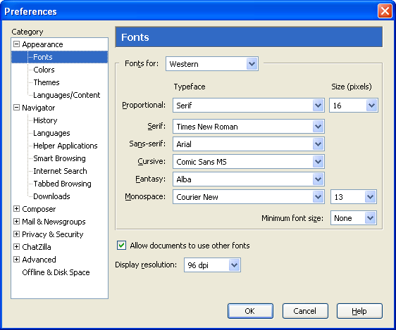
CSS Font Properties
generic
fonts are
system-
specific
Jackson, Web Technologies: A Computer Science Perspective, © 2007 Prentice-Hall, Inc. All rights reserved. 0-13-185603-0

Slide 46
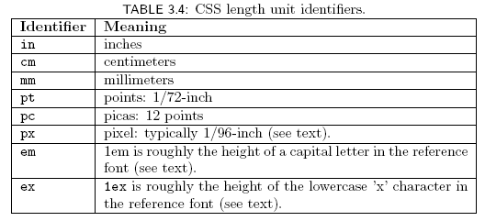
CSS Font Properties
Many properties, such as font-size, have a value that is a CSS length
All CSS length values except 0 need units
Jackson, Web Technologies: A Computer Science Perspective, © 2007 Prentice-Hall, Inc. All rights reserved. 0-13-185603-0

Slide 47
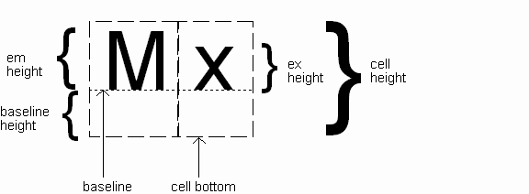
CSS Font Properties
Computed value
of font-size
property
Jackson, Web Technologies: A Computer Science Perspective, © 2007 Prentice-Hall, Inc. All rights reserved. 0-13-185603-0

Slide 48
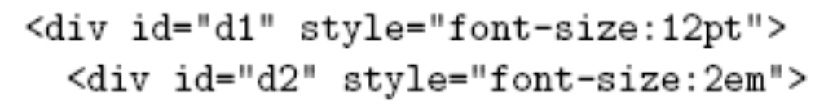
CSS Font Properties
Reference font defines em and ex units
  Normally, reference font is the font of the element being styled
  Exception: Using em/ex to specify value for font-size
parent element’s font is
reference font
Jackson, Web Technologies: A Computer Science Perspective, © 2007 Prentice-Hall, Inc. All rights reserved. 0-13-185603-0

Slide 49

CSS Font Properties
Other ways to specify value for
font-size:
  Percentage (of parent font-size)
  Absolute size keyword: xx-small, x-small, small, medium (initial value), large,
  x-large, xx-large
    User agent specific; should differ by ~ 20%
  Relative size keyword: smaller, larger
    Relative to parent element’s font
Jackson, Web Technologies: A Computer Science Perspective, © 2007 Prentice-Hall, Inc. All rights reserved. 0-13-185603-0

Slide 50
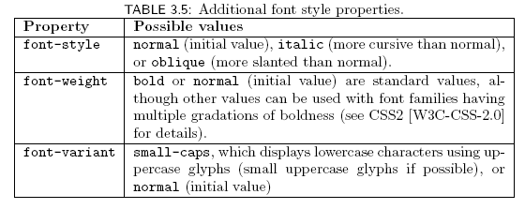
CSS Font Properties
Jackson, Web Technologies: A Computer Science Perspective, © 2007 Prentice-Hall, Inc. All rights reserved. 0-13-185603-0

Slide 51

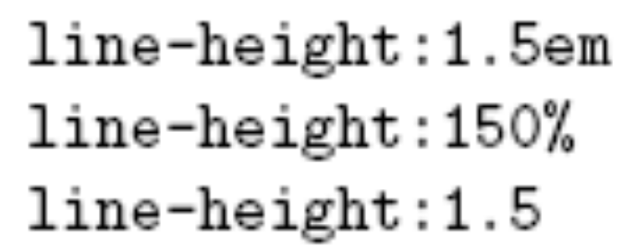
CSS Font Properties
Text is rendered using line boxes
Height of line box given by line-height
  Initial value: normal (i.e., cell height; relationship with em height is font-specific)
  Other values (following are equivalent):
Jackson, Web Technologies: A Computer Science Perspective, © 2007 Prentice-Hall, Inc. All rights reserved. 0-13-185603-0

Slide 52
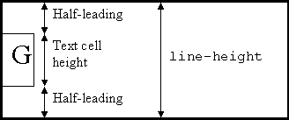
CSS Font Properties
When line-height is greater than cell height:
Inheritance of line-height:
  Specified value if normal or unit-less number
  Computed value otherwise
Jackson, Web Technologies: A Computer Science Perspective, © 2007 Prentice-Hall, Inc. All rights reserved. 0-13-185603-0

Slide 53
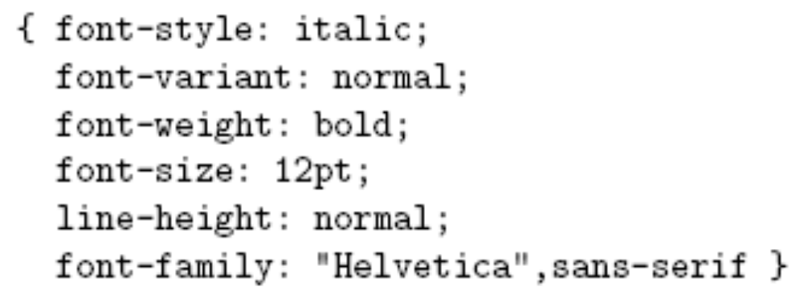
CSS Font Properties
font shortcut property:
Jackson, Web Technologies: A Computer Science Perspective, © 2007 Prentice-Hall, Inc. All rights reserved. 0-13-185603-0

Slide 54
CSS Font Properties
font shortcut property:
Jackson, Web Technologies: A Computer Science Perspective, © 2007 Prentice-Hall, Inc. All rights reserved. 0-13-185603-0

Slide 55
CSS Font Properties
font shortcut property:
Jackson, Web Technologies: A Computer Science Perspective, © 2007 Prentice-Hall, Inc. All rights reserved. 0-13-185603-0

Slide 56
CSS Font Properties
font shortcut property:
Jackson, Web Technologies: A Computer Science Perspective, © 2007 Prentice-Hall, Inc. All rights reserved. 0-13-185603-0

Slide 57
CSS Font Properties
font shortcut property:
Jackson, Web Technologies: A Computer Science Perspective, © 2007 Prentice-Hall, Inc. All rights reserved. 0-13-185603-0

Slide 58
CSS Font Properties
font shortcut property:
Initial values used if no value specified in font
property list
Jackson, Web Technologies: A Computer Science Perspective, © 2007 Prentice-Hall, Inc. All rights reserved. 0-13-185603-0

Slide 59
CSS Font Properties
font shortcut property:
specifying line-height
any order
size and family required,
order-dependent
Jackson, Web Technologies: A Computer Science Perspective, © 2007 Prentice-Hall, Inc. All rights reserved. 0-13-185603-0

Slide 60
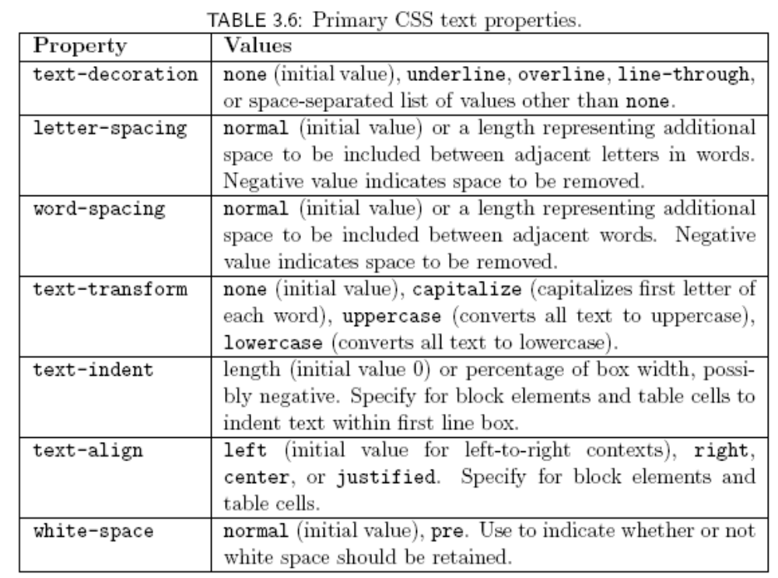
CSS Text Formatting
Jackson, Web Technologies: A Computer Science Perspective, © 2007 Prentice-Hall, Inc. All rights reserved. 0-13-185603-0

Slide 61
CSS Text Color
Font color specified by color property
Two primary ways of specifying colors:
  Color name: black, gray, silver, white, red, lime, blue, yellow, aqua, fuchsia, maroon, green, navy, olive, teal, purple, full list at
  http://www.w3.org/TR/SVG11/types.html#ColorKeywords
  red/green/blue (RGB) values
Jackson, Web Technologies: A Computer Science Perspective, © 2007 Prentice-Hall, Inc. All rights reserved. 0-13-185603-0

Slide 62
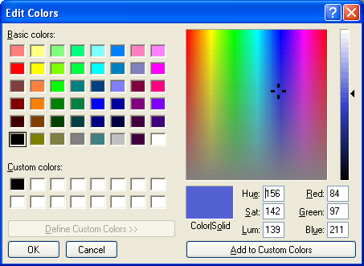
CSS Text Color
Jackson, Web Technologies: A Computer Science Perspective, © 2007 Prentice-Hall, Inc. All rights reserved. 0-13-185603-0

Slide 63
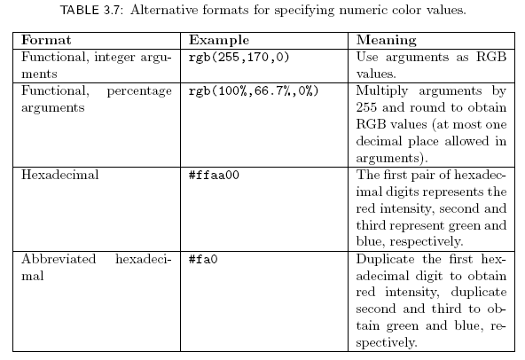
CSS Text Color
Jackson, Web Technologies: A Computer Science Perspective, © 2007 Prentice-Hall, Inc. All rights reserved. 0-13-185603-0

Slide 64
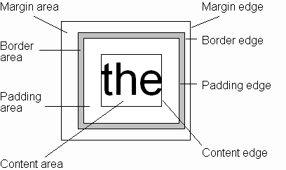
CSS Box Model
Every rendered element occupies a box:
(or outer edge)
(or inner edge)
Jackson, Web Technologies: A Computer Science Perspective, © 2007 Prentice-Hall, Inc. All rights reserved. 0-13-185603-0

Slide 65
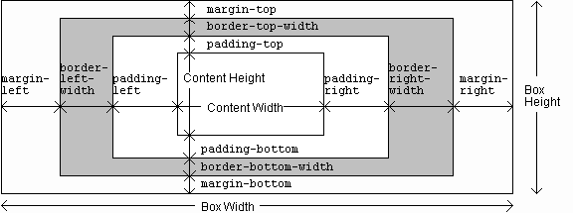
CSS Box Model
Jackson, Web Technologies: A Computer Science Perspective, © 2007 Prentice-Hall, Inc. All rights reserved. 0-13-185603-0

Slide 66
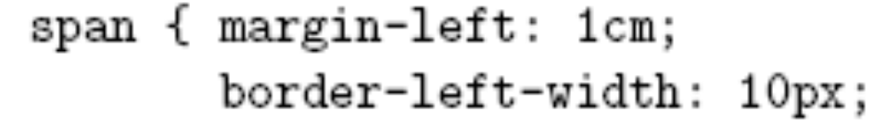
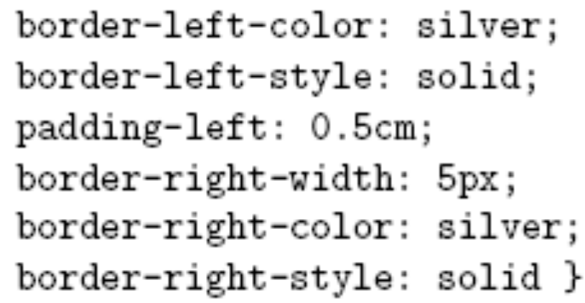
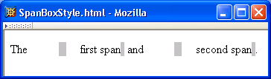
CSS Box Model
Jackson, Web Technologies: A Computer Science Perspective, © 2007 Prentice-Hall, Inc. All rights reserved. 0-13-185603-0

Slide 67
CSS Box Model
Jackson, Web Technologies: A Computer Science Perspective, © 2007 Prentice-Hall, Inc. All rights reserved. 0-13-185603-0

Slide 68
CSS Box Model
Jackson, Web Technologies: A Computer Science Perspective, © 2007 Prentice-Hall, Inc. All rights reserved. 0-13-185603-0

Slide 69
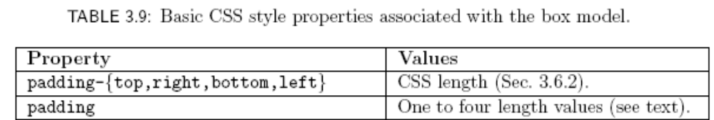
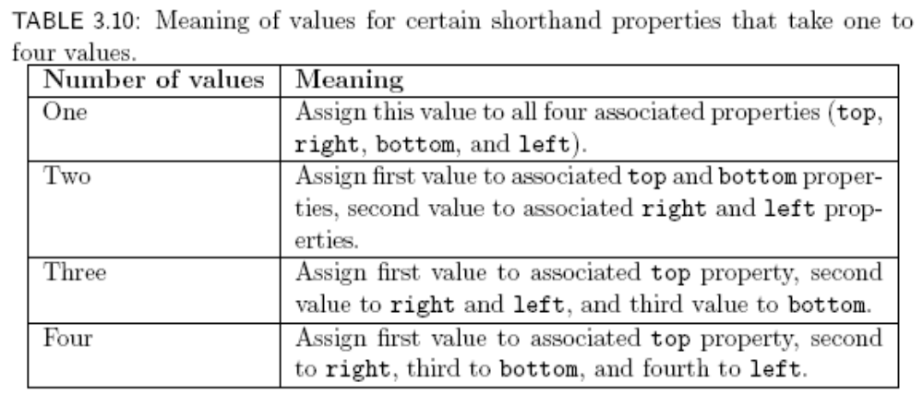
CSS Box Model
Jackson, Web Technologies: A Computer Science Perspective, © 2007 Prentice-Hall, Inc. All rights reserved. 0-13-185603-0

Slide 70
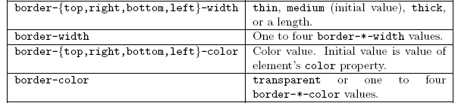
CSS Box Model
Jackson, Web Technologies: A Computer Science Perspective, © 2007 Prentice-Hall, Inc. All rights reserved. 0-13-185603-0

Slide 71
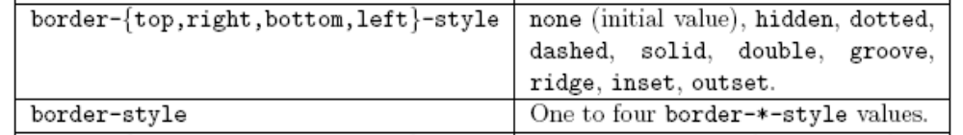
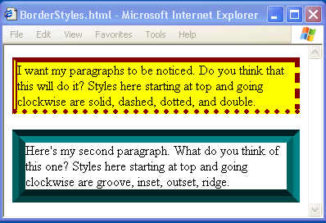
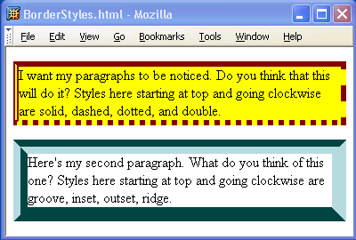
CSS Box Model
Jackson, Web Technologies: A Computer Science Perspective, © 2007 Prentice-Hall, Inc. All rights reserved. 0-13-185603-0

Slide 72
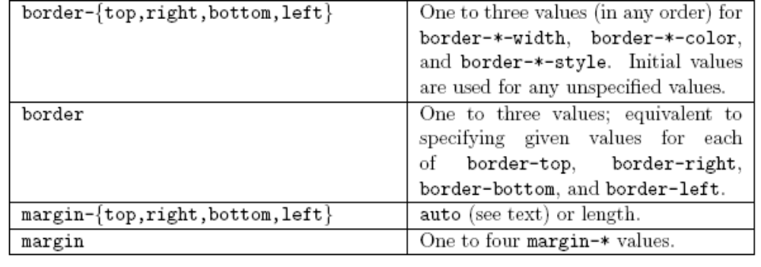
CSS Box Model
Jackson, Web Technologies: A Computer Science Perspective, © 2007 Prentice-Hall, Inc. All rights reserved. 0-13-185603-0

Slide 73
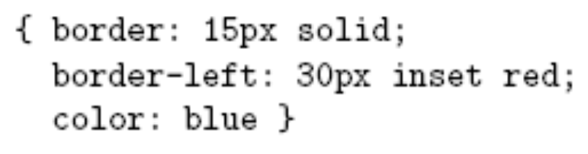
CSS Box Model
If multiple declarations apply to a property, the last declaration overrides earlier specifications
Left border is 30px wide,
inset style, and red
Jackson, Web Technologies: A Computer Science Perspective, © 2007 Prentice-Hall, Inc. All rights reserved. 0-13-185603-0

Slide 74
Backgrounds
background-color
  Specifies background color for content, padding, and border areas
  Margin area is always transparent
  Not inherited; initial value transparent
background-image
  Specifies (using url() function) image that will be tiled over an element
Jackson, Web Technologies: A Computer Science Perspective, © 2007 Prentice-Hall, Inc. All rights reserved. 0-13-185603-0

Slide 75
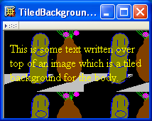
Backgrounds
<body style="background-image:url('CucumberFlowerPot.png')">
Jackson, Web Technologies: A Computer Science Perspective, © 2007 Prentice-Hall, Inc. All rights reserved. 0-13-185603-0

Slide 76
Normal Flow Layout
In normal flow processing, each displayed element has a corresponding box
  html element box is called initial containing block and corresponds to entire document
  Boxes of child elements are contained in boxes of parent
  Sibling block elements are laid out one on top of the other
  Sibling inline elements are one after the other
Jackson, Web Technologies: A Computer Science Perspective, © 2007 Prentice-Hall, Inc. All rights reserved. 0-13-185603-0

Slide 77
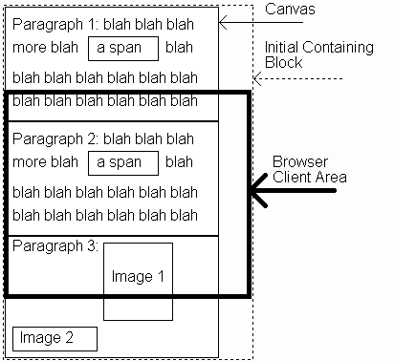
Normal Flow Layout
(body)
(html)
Jackson, Web Technologies: A Computer Science Perspective, © 2007 Prentice-Hall, Inc. All rights reserved. 0-13-185603-0

Slide 78
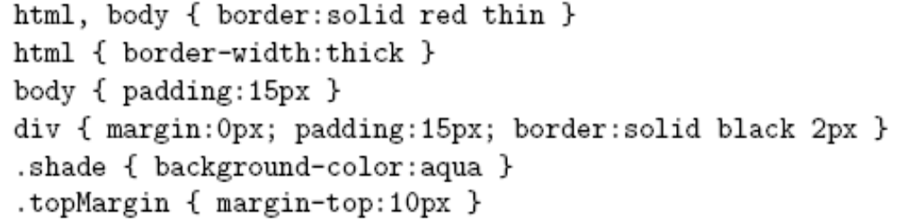
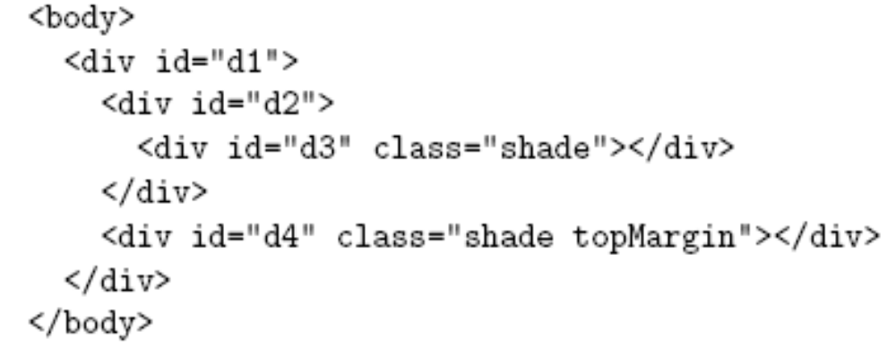
Normal Flow Layout
Block
elements
only
Jackson, Web Technologies: A Computer Science Perspective, © 2007 Prentice-Hall, Inc. All rights reserved. 0-13-185603-0

Slide 79
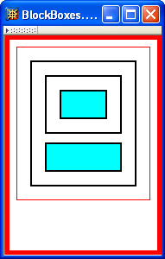
Normal Flow Layout
html
body
div d1
div d2
div d3
div d4
Top edges of
block boxes are
in document order
Jackson, Web Technologies: A Computer Science Perspective, © 2007 Prentice-Hall, Inc. All rights reserved. 0-13-185603-0

Slide 80
Normal Flow Layout
What is a “block element”?
  Element with value block specified for its display property
  User agent style sheet (not CSS) specifies default values; typical block elements include html, body, p, pre, div, form, ol, ul, dl, hr, h1 through h6
  Most other elements except li and table-related have inline specified for display
Jackson, Web Technologies: A Computer Science Perspective, © 2007 Prentice-Hall, Inc. All rights reserved. 0-13-185603-0

Slide 81
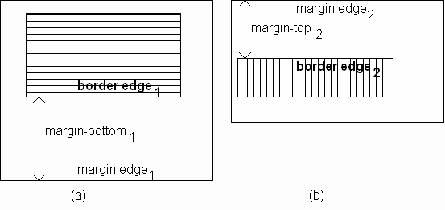
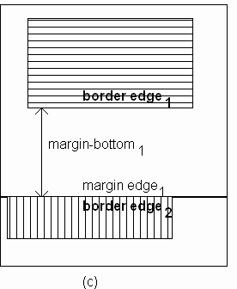
Normal Flow Layout
When blocks stack, adjacent margins are collapsed to the size of the larger margin
Jackson, Web Technologies: A Computer Science Perspective, © 2007 Prentice-Hall, Inc. All rights reserved. 0-13-185603-0

Slide 82
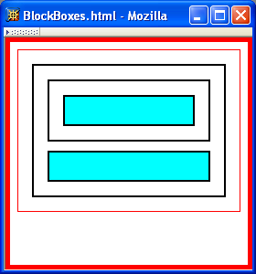
Normal Flow Layout
Initial value of width property is auto, which for block boxes means to make the content area as wide as possible within margin/padding constraints:
Width of block boxes
increases as browser
client area is widened
Jackson, Web Technologies: A Computer Science Perspective, © 2007 Prentice-Hall, Inc. All rights reserved. 0-13-185603-0

Slide 83
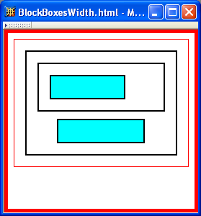

Normal Flow Layout
Can also specify CSS length or percentage (of parent’s content width) for width property
By default, width of right margin is adjusted to accommodate a change to width
Jackson, Web Technologies: A Computer Science Perspective, © 2007 Prentice-Hall, Inc. All rights reserved. 0-13-185603-0

Slide 84
Normal Flow Layout
Can also specify CSS length or percentage (of parent’s content width) for width property
Centering can be achieved by setting
both margins to auto
Jackson, Web Technologies: A Computer Science Perspective, © 2007 Prentice-Hall, Inc. All rights reserved. 0-13-185603-0

Slide 85
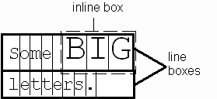
Normal Flow Layout
Boxes corresponding to character cells and inline elements are laid out side by side in line boxes that are stacked one on top of the other
Heights based on
content
Character cells aligned by baseline
Jackson, Web Technologies: A Computer Science Perspective, © 2007 Prentice-Hall, Inc. All rights reserved. 0-13-185603-0

Slide 86


Normal Flow Layout
Padding/borders/margins affect width but not height of inline boxes
Jackson, Web Technologies: A Computer Science Perspective, © 2007 Prentice-Hall, Inc. All rights reserved. 0-13-185603-0

Slide 87

Normal Flow Layout
Specify value for vertical-align to position an inline element within line box:
initial value of vertical-align
Jackson, Web Technologies: A Computer Science Perspective, © 2007 Prentice-Hall, Inc. All rights reserved. 0-13-185603-0

Slide 88

Beyond Normal Flow
CSS allows for boxes to be positioned outside the normal flow:
  Relative positioning
span’s shifted backwards relative to normal flow
Jackson, Web Technologies: A Computer Science Perspective, © 2007 Prentice-Hall, Inc. All rights reserved. 0-13-185603-0

Slide 89
Beyond Normal Flow
CSS allows for boxes to be positioned outside the normal flow:
  Relative positioning
other span’s are not affected
Jackson, Web Technologies: A Computer Science Perspective, © 2007 Prentice-Hall, Inc. All rights reserved. 0-13-185603-0

Slide 90
Beyond Normal Flow
CSS allows for boxes to be positioned outside the normal flow:
  Relative positioning
<span style="background-color:red">&nbsp;&nbsp;&nbsp;&nbsp;
</span><span class="right">Red</span>
<span style="background-color:yellow">&nbsp;&nbsp;&nbsp;&nbsp;
</span><span class="right">Yellow</span>
<span style="background-color:lime">&nbsp;&nbsp;&nbsp;&nbsp;
</span><span class="right">Green</span>
style rules that move span’s
away from normal-flow right edge
Jackson, Web Technologies: A Computer Science Perspective, © 2007 Prentice-Hall, Inc. All rights reserved. 0-13-185603-0

Slide 91

Beyond Normal Flow
CSS allows for boxes to be positioned outside the normal flow:
  Float positioning
style rule that “floats” left
Jackson, Web Technologies: A Computer Science Perspective, © 2007 Prentice-Hall, Inc. All rights reserved. 0-13-185603-0

Slide 92

Beyond Normal Flow
CSS allows for boxes to be positioned outside the normal flow:
  Float positioning
span taken out of normal
flow and “floated” to the
left of its line box
Jackson, Web Technologies: A Computer Science Perspective, © 2007 Prentice-Hall, Inc. All rights reserved. 0-13-185603-0

Slide 93

Beyond Normal Flow
CSS allows for boxes to be positioned outside the normal flow:
  Absolute positioning
style rule that moves span relative to
upper left corner of containing
p element’s box
Jackson, Web Technologies: A Computer Science Perspective, © 2007 Prentice-Hall, Inc. All rights reserved. 0-13-185603-0

Slide 94

Beyond Normal Flow
CSS allows for boxes to be positioned outside the normal flow:
  Absolute positioning
span’s removed from
normal flow and
positioned relative
to another box
Jackson, Web Technologies: A Computer Science Perspective, © 2007 Prentice-Hall, Inc. All rights reserved. 0-13-185603-0

Slide 95
Beyond Normal Flow
Properties used to specify positioning:
  position: static (initial value), relative, or absolute
    Element is positioned if this property not static
    Properties left, right, top, bottom apply to positioned elements
      Primary values are auto (initial value) or CSS length
  float: none, left, or right
    Applies to elements with static and relative positioning only
Jackson, Web Technologies: A Computer Science Perspective, © 2007 Prentice-Hall, Inc. All rights reserved. 0-13-185603-0

Slide 96
Beyond Normal Flow
Relative positioning
  Specifying positive value for right property of relatively positioned box moves it to left
<span style="background-color:red">&nbsp;&nbsp;&nbsp;&nbsp;
</span><span class="right">Red</span>
span
containing
text moves
left
Jackson, Web Technologies: A Computer Science Perspective, © 2007 Prentice-Hall, Inc. All rights reserved. 0-13-185603-0

Slide 97
Beyond Normal Flow
Relative positioning
  Specifying negative value for left property also moves box to left
<span style="background-color:red">&nbsp;&nbsp;&nbsp;&nbsp;
</span><span class="right">Red</span>
same
effect as
before
Jackson, Web Technologies: A Computer Science Perspective, © 2007 Prentice-Hall, Inc. All rights reserved. 0-13-185603-0

Slide 98

Beyond Normal Flow
Float positioning
  Specify value for float property
Jackson, Web Technologies: A Computer Science Perspective, © 2007 Prentice-Hall, Inc. All rights reserved. 0-13-185603-0

Slide 99
Beyond Normal Flow
Float positioning
  Specify value for float property
Floated element becomes a CSS block
element (e.g., can set height and width)
Jackson, Web Technologies: A Computer Science Perspective, © 2007 Prentice-Hall, Inc. All rights reserved. 0-13-185603-0

Slide 100
Beyond Normal Flow
Absolute positioning
  Specify location for corner of box relative to positioned containing block
p elements are positioned (but don’t move!)
margin area
padding area
containing
block
This second paragraph has a
note.
Jackson, Web Technologies: A Computer Science Perspective, © 2007 Prentice-Hall, Inc. All rights reserved. 0-13-185603-0

Slide 101

Beyond Normal Flow
Absolute positioning
  Specify location for edges of box relative to positioned containing block
Jackson, Web Technologies: A Computer Science Perspective, © 2007 Prentice-Hall, Inc. All rights reserved. 0-13-185603-0

Slide 102


Beyond Normal Flow
Absolute positioning
10em
padding top
edge
padding left
edge
Jackson, Web Technologies: A Computer Science Perspective, © 2007 Prentice-Hall, Inc. All rights reserved. 0-13-185603-0

Slide 103
Beyond Normal Flow
Absolute positioning
8em
Jackson, Web Technologies: A Computer Science Perspective, © 2007 Prentice-Hall, Inc. All rights reserved. 0-13-185603-0

Slide 104

Beyond Normal Flow
Absolutely positioned box does not affect positioning of other boxes!
Second absolutely
positioned box
obscures first
Jackson, Web Technologies: A Computer Science Perspective, © 2007 Prentice-Hall, Inc. All rights reserved. 0-13-185603-0

Slide 105


CSS Position-Related Properties
z-index: drawing order for overlaid boxes (largest number drawn last)
Jackson, Web Technologies: A Computer Science Perspective, © 2007 Prentice-Hall, Inc. All rights reserved. 0-13-185603-0

Slide 106
CSS Position-Related Properties
display: value none means that element and its descendants are not rendered and do not affect normal flow
visibility: value hidden (initial value is visible) means that element and its descendants are not rendered but still do affect normal flow
Jackson, Web Technologies: A Computer Science Perspective, © 2007 Prentice-Hall, Inc. All rights reserved. 0-13-185603-0

